Slide 1
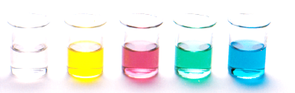
Carbonyl containing functional groups
Lesson outcomes
Aldehydes – nomenclature and properties
Ketones – nomenclature and properties
Carboxylic acids – nomenclature and properties
Resources
Essential chemistry, ch 11.4 to 11.6, pages 119
Set 16 Q 6 – 11

Slide 2
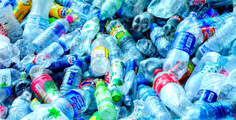
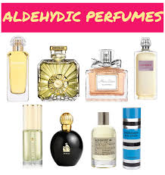
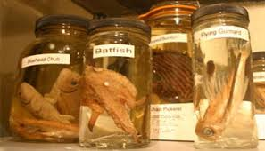
Aldehydes

Slide 3
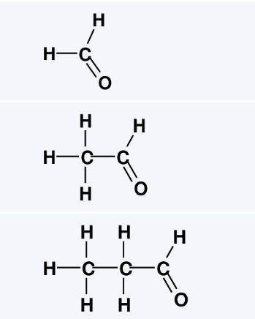
Naming aldehydes
What were the three aldehydes we made with the molymods in lab 29?
Methanal
HCHO
HCHO
Ethanal
CH₃CHO
CH₃CHO
Propanal
C₂H₅CHO
CH₃CH₂CHO

Slide 4
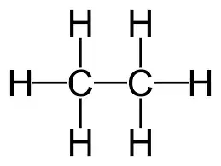

Naming aldehydes
Aldehydes contain a carbon-oxygen double bond called a carbonyl group
In aldehydes the carbonyl group is always on the terminal end of the carbon chain, giving the General Formula R-CHO (note – the hydrogen is attached to the carbon not the oxygen) – So, no position isomers of aldehydes
Naming we drop the e from the parent alkane and add the suffix -al
Replace two H with double bond to oxygen
Replace the final e with -al
ethane
ethanal

Slide 5
Properties of aldehydes
Aldehydes are polar molecules but cannot interact with each other through hydrogen bonding
This is because aldehydes do not contain a significantly polar hydrogen (it is attached to a carbon rather then an electronegative element such as O or N)
Low molecular weight aldehydes dominate IMF are dipole-dipole

Slide 6
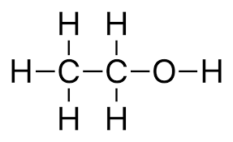
Properties of aldehydes
ethane
ethanal
ethanol
BP -89 °C
<
BP 20.2°C
<
BP 78.4°C
<
<
Dispersion forces
Dipole-dipole
Hydrogen bonding

Slide 7
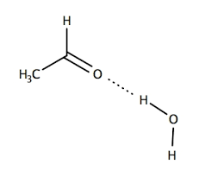
Properties of aldehydes
Solubility
Low molecular weight aldehydes attracted to one another by dipole-dipole interactions – so they are soluble in other substances that also have strong dipole-dipole interactions
Aldehydes can hydrogen bond with water – the lone pair of electrons on the carbonyl oxygen, hydrogen bonds to the proton of water
Low molecular weight aldehydes are soluble in water

Slide 8
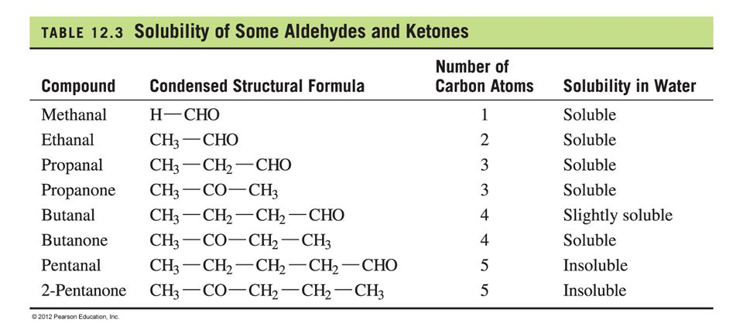
Properties of aldehydes
Solubility
High molecular weight aldehydes dispersion forces increase and become significant. Increasing their solubility in non-polar substances that also have strong dispersion force interactions

Slide 9

Ketones

Slide 10
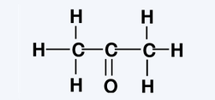
Naming ketones
What was the ketone we made with the molymods in lab 29?
Propanone
C₂H₆CO
CH₃COCH₃
Compare:
Both – C₃H₆O
Difference – position of the carbonyl group
Propanone
Propanal

Slide 11
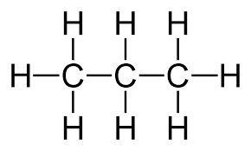
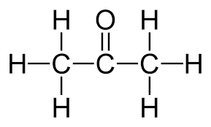
Naming ketones
Ketones contain a carbon-oxygen double bond called a carbonyl group
In Ketones the carbonyl group is always on a secondary carbon (ie not at terminal end of carbon chain). We use numbers to specify the position of the carbonyl group
Naming we drop the e from the parent alkane and add the suffix -one
Replace two H with double bond to oxygen
Replace the final e with -one
propane
propanone

Slide 12
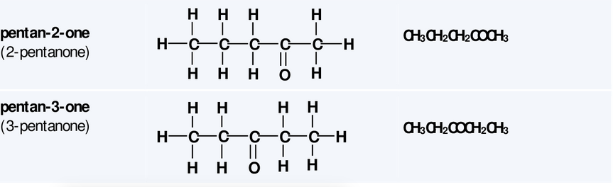
Naming ketones
Ketones positional isomers

Slide 13
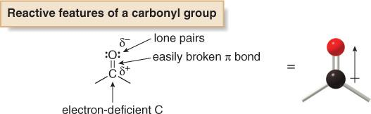
Properties of ketones
Ketones are polar molecules but cannot interact with each other through hydrogen bonding
Low molecular weight aldehydes dominate IMF are dipole-dipole

Slide 14
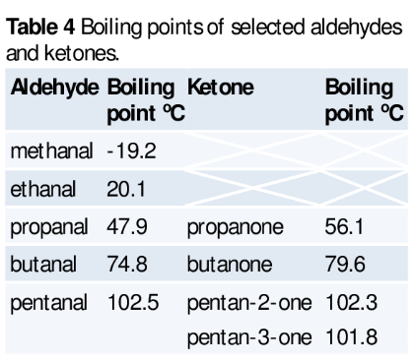
Properties of ketones
Boiling point
Similar boiling points to aldehydes. Higher than alkane (only contain dispersion forces) but lower than alcohols (contain hydrogen bonding)
Solubility
Low molecular weight – soluble in water (due to hydrogen bonding between carbonyl and H₂O)
As MW increases becomes more soluble in non-polar substances (due to increasing dispersion forces)

Slide 15
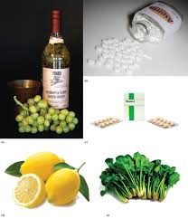
Carboxylic acids
carboxylic Acids in the Home. Carboxylic acids occur in many common household items. (a) Vinegar contains acetic acid, (b) aspirin is acetylsalicylic acid, (c) vitamin C is ascorbic acid, (d) lemons contain citric acid, and (e) spinach contains oxalic acid.

Slide 16
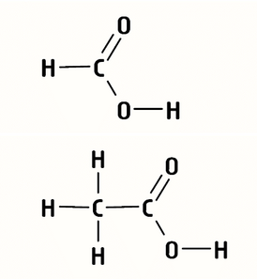
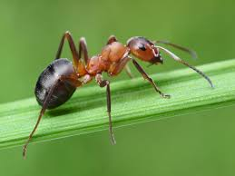
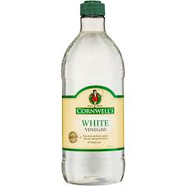
Naming carboxylic acids
What were the two carboxylic acids we made with the molymods in lab 29?
Methanoic acid
CH₂O₂
HCOOH
Ethanoic acid
C₂H₅O₂
CH₃COOH

Slide 17
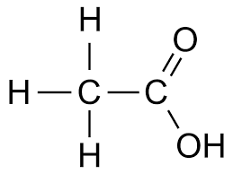
Naming carboxylic acids
Aldehydes contain a carboxyl group (carbonyl + hydroxyl)
giving the General Formula R-COOH they only occur at the terminal end of a carbon chain, so no number is needed to specify their position
Naming we drop the e from the parent alkane and add the suffix –oic acid
Replace three H with double bond to oxygen and hydroxyl group (-OH)
Replace the final e with –oic acid
ethane
Ethanoic acid

Slide 18
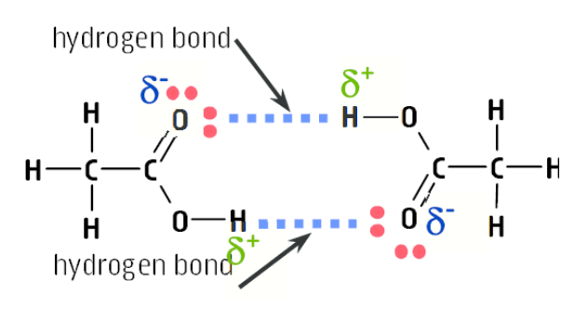
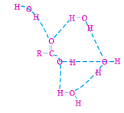
Properties of carboxylic acids
Carboxylic acids can form Hydrogen bonded dimers
Carboxylic acid form multiple hydrogen bonds to water

Slide 19
Properties of carboxylic acids
Use your knowledge of IMF to predict the properties of carboxylic acid compared to the other functional group compounds you know.
Boiling Point
Low MW – dominate IMF is hydrogen bonding.
Carboxylic acid > alcohol > aldehyde/ketone > alkane
High MW – dispersion forces increase
High MW carboxylic acids > Low MW carboxylic acids
ethanoic acid 117.9 °C
ethanol 78.3 °C
Solubility
Low MW – soluble in polar substances, particularly water and alcohols that can form hydrogen bonding interactions
High MW – as MW increases so does the solubility in non-polar substances. Hexanoic acid is partially soluble in water, longer chains are insoluble in water.

Slide 20
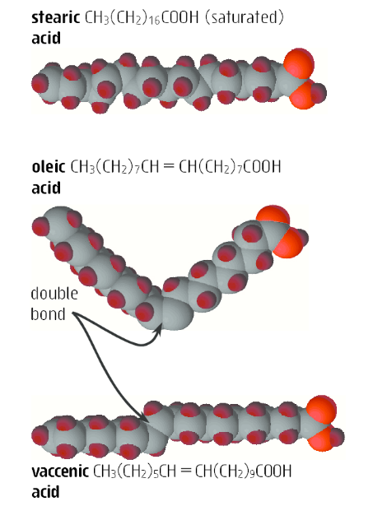
Fatty acids
Long chain carboxylic acids are known as fatty acids
They feel greasing and are insoluble in water
Occur naturally in living systems
Plant fatty acids – unsaturated, cis- configuration
Animal fatty acids – saturated
Small number of animals produce vaccenic acid – a unsaturated fatty acid with a trans-configuration
Naturally occurring fatty acids have an even number of carbons in the chain (commonly 16 or 18 carbons)

Slide 21
Fatty acids
Fatty acids are chemically related to, but not the same as fats and oils (we will do fats and oils later)
In plants and animals, fatty acids are converted into triglycerides (which are commonly known as fats and oils)
Triglycerides are an important store of energy for living systems

Slide 22
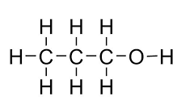
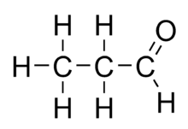
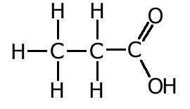
Summary - naming
Group | General formula | suffix | Position numbered? | Example | Structural formula
Alcohol | R-OH | -ol | Yes | Propan-1-ol
Aldehyde | R-CHO | -al | No* | Propanal
Ketone | R-CO-R | -one | Yes | Propanone
Carboxylic acid | R-COOH | -oic acid | No* | Propanoic acid
* Functional group located at terminal end of carbon chain so no number is required

Slide 23
Summary - properties
Group | General formula | Low Molecular weight | High Molecular weight | Boiling point (of similar MW) | Solubility
Alcohol | R-OH | Hydrogen Bonding | Dispersion forces | Higher - alkanes, aldehydes and ketones Lower - carboxylic acids | LMW – polar, highly solubility in water HMW – non-polar, low solubility in water
Aldehyde | R-CHO | Dipole-dipole (H bonding with water) | Dispersion forces | Higher – alkanes Same – ketones Lower – alcohols and carboxylic acids | LMW – polar, highly solubility in water HMW – non-polar, low solubility in water
Ketone | R-CO-R | Dipole-Dipole (H bonding with water) | Dispersion forces | Higher – alkanes Same – ketones Lower – alcohols and carboxylic acids | LMW – polar, highly solubility in water HMW – non-polar, low solubility in water
Carboxylic acid | R-COOH | Hydrogen bonding | Dispersion forces | Higher than alkanes, alcohols, aldehydes, and ketones | LMW – polar, highly solubility in water HMW – non-polar, low solubility in water

Slide 24
On going work
Set 16 Q1-5 (alcohols), 6-7 (aldehyde/ketones), 8-9 (carboxylic acids)
Set 15 Q 1,2, 6-11, 12-16
Finish Experiment 29 – you should have a completed table with all examples drawn (even the ones you didn’t have time to build); add the general formulae; and add uses for the different groups of compounds (e.g uses of alcohols, uses of aldehydes etc)

